Slide 1
Impact of Taylor Swift on the Chiefs and Super Bowl LVIII
By: Christopher Abbes, Davis Bove, and Megan Gibson

Slide 2
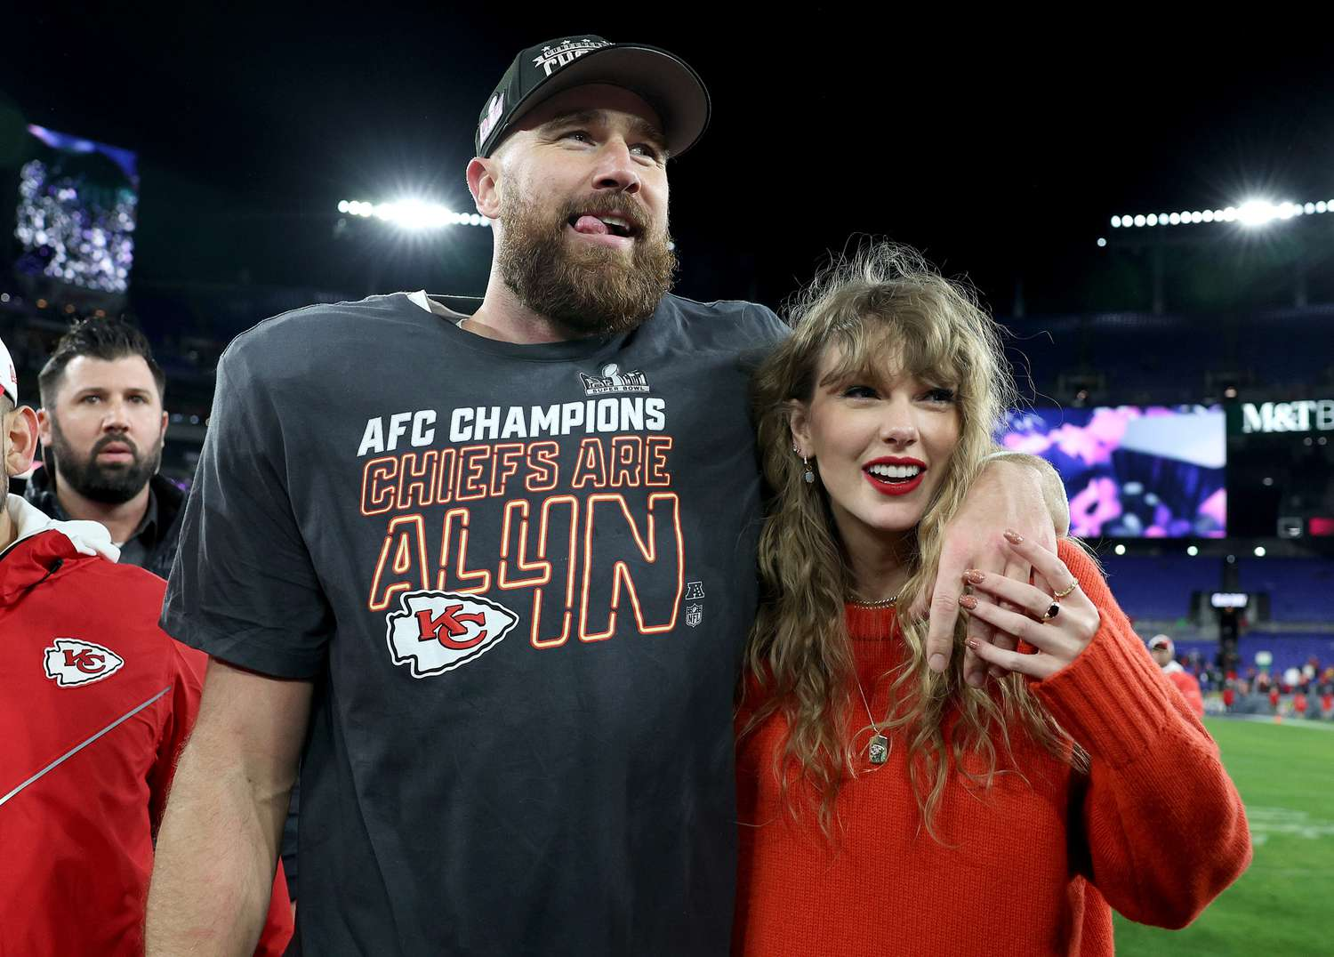

Background Information
Taylor Swift and Travis Kelce have been dating since September 2023.
At the time they began dating, Travis was playing in the NFL season (which began that same month and concluded in February 2024 with the Super Bowl) for the Kansas City Chiefs and Taylor was performing in her Eras Tour (which began in March 2023 and will last until December 2024).
Notes:
Megan - financial impact of Taylor on the Chiefs and Super Bowl viewers

Slide 3
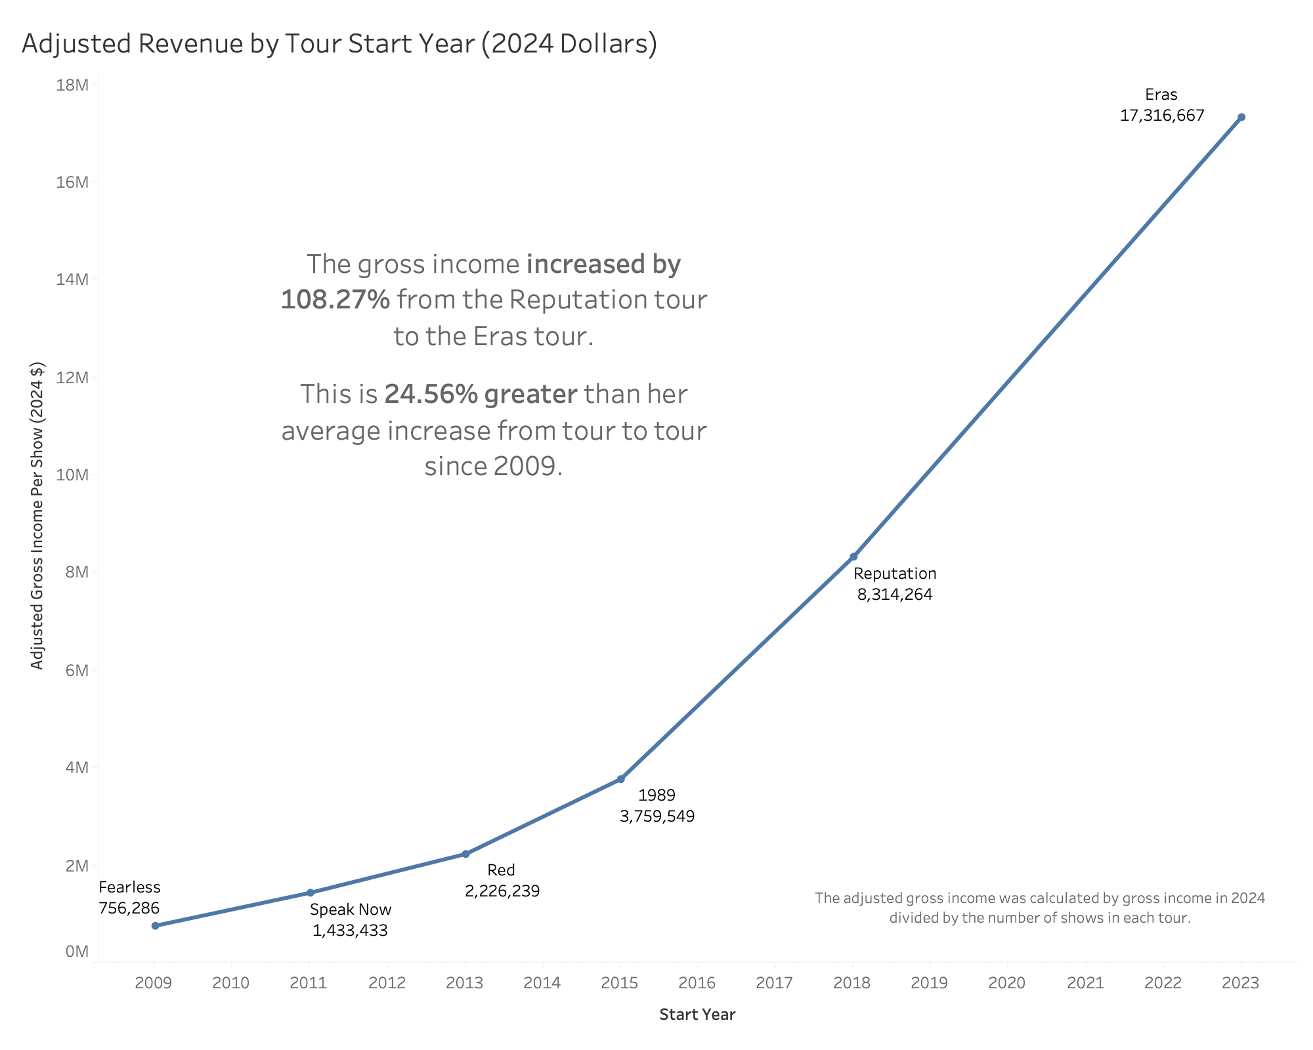
Taylor Swift Income per Tour
Notes:
Megan - i’ll think of a script for this
Clearly taylor swift is doing well for herself as we can see her tour is doing better than any previous
But did she really help the chiefs/nfl

Slide 4
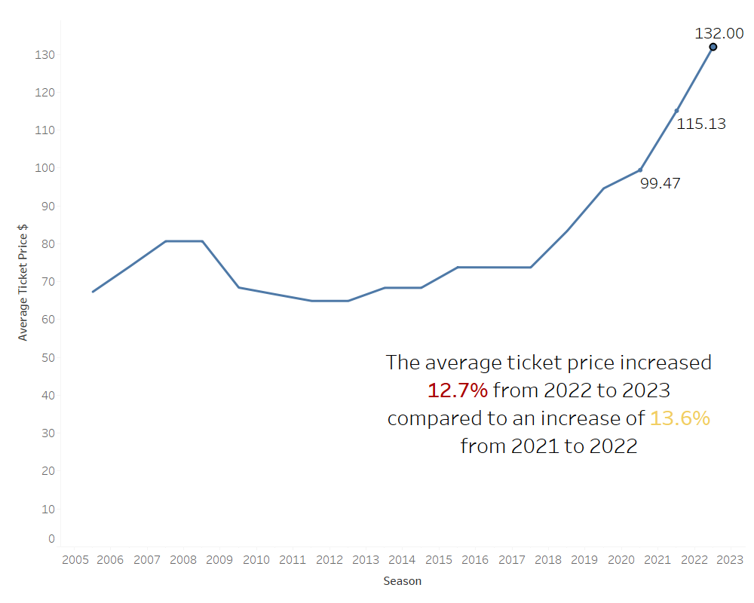
Did Taylor help the Chiefs’ ticket sales?

Slide 5
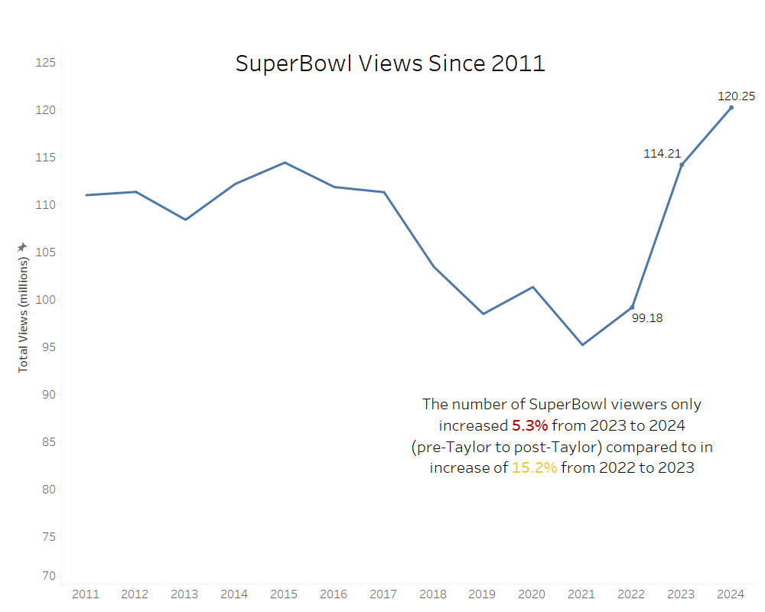
Did Taylor really impact Super Bowl viewership?

Slide 6
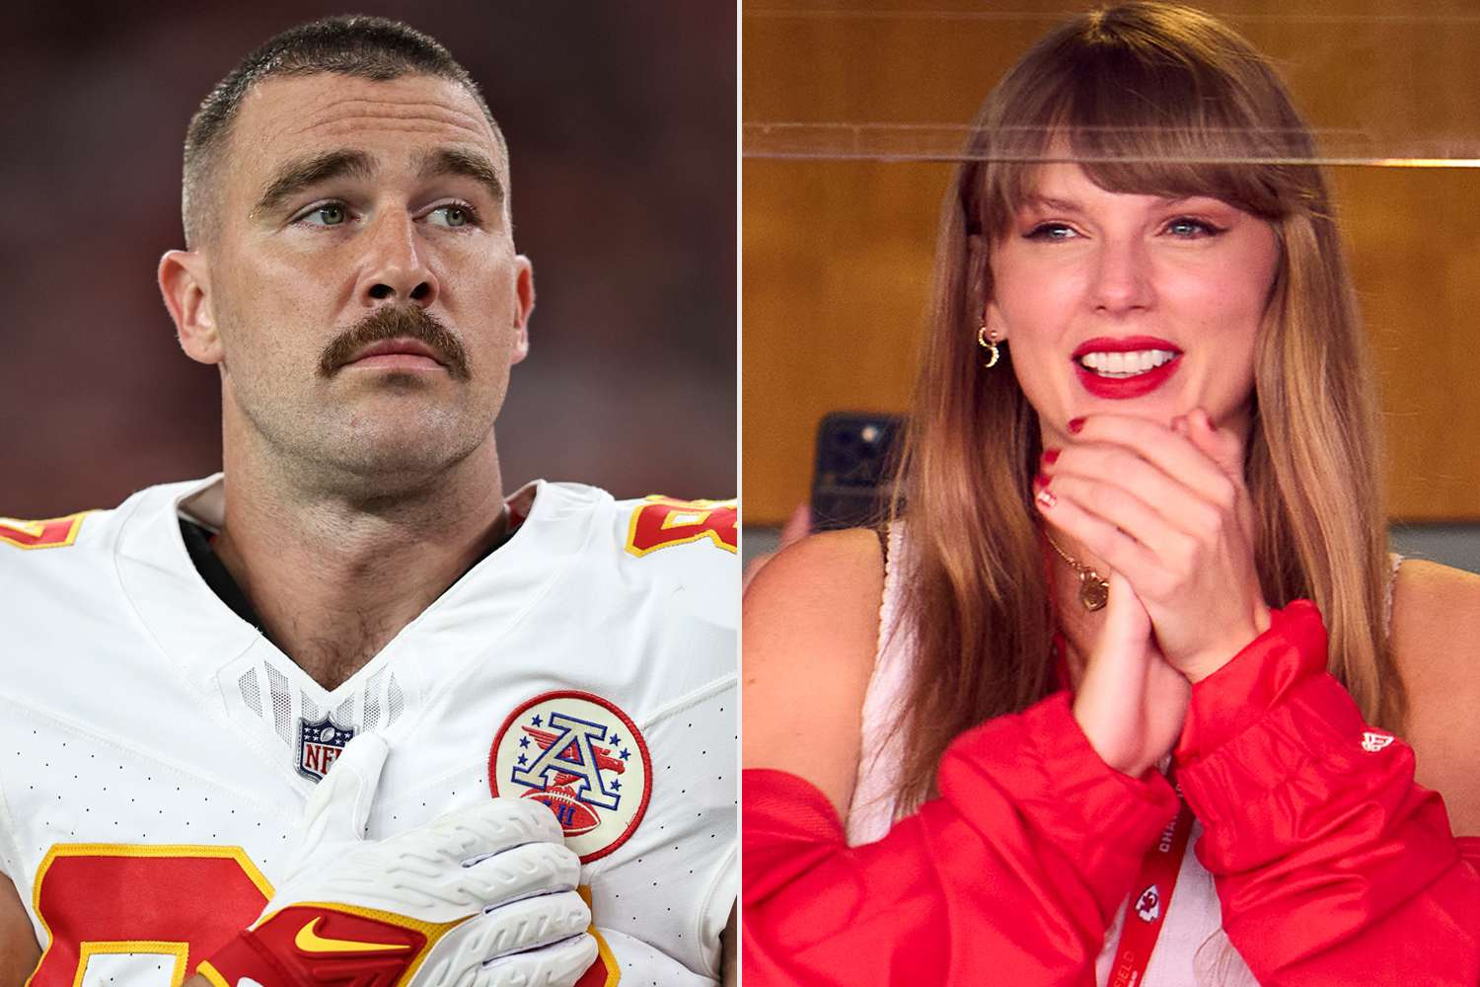
Conclusion
Based on the data:
Taylor + Travis did not impact the Super Bowl viewership
Or the Chiefs’ ticket sales

